Slide 1
PENNYSTACK: Smart Personal Expense Tracker
A Hybrid Data Structure Approach
Presented By: Abdul Rafay (243705)
Course: Data Structures - Spring 2025
Instructor: Mr. Syed Atta Ur Rehman
Air University Multan Campus

Slide 2

Presentation Agenda
Problem Statement & Motivation
Project Objectives
System Overview
Data Structures Implementation
System Architecture
Key Features & Demo
Implementation Details
Testing & Results
Challenges Faced
Future Enhancements
Conclusion & Q&A Session

Slide 3
The Problem: Financial Mismanagement
Current Challenges
Real-World Impact
Manual tracking takes too much time and leads to mistakes.
60% of people don't track their spending regularly.
The average person makes 3-4 financial mistakes each month.
There's no organized system for paying bills.
It's hard to understand where your money is going.
Bills are often paid late because of poor scheduling.
You could lose important financial data without reliable backups.
Not knowing your spending usually leads to overspending.
These common problems show a clear need for a better financial management tool.

Slide 4
PENNYSTACK: The Smart Solution
PennyStack is a console-based C++ application designed to tackle common financial mismanagement issues head-on, leveraging advanced data structures for optimal performance and reliability.
Multiple Data Types
Fast Processing
Auto-Save
Uses 5 different data types. They work together to handle all features.
Processes information quickly. This ensures a smooth and speedy experience.
Your data is saved automatically. You won't lose your financial records.
PIN Protection
Quick Undo
Log in securely with a PIN. Extra security measures protect your account.
Instantly undo any mistakes. Easily correct entries if needed.

Slide 5
Project Objectives
Primary Goals
Secondary Goals
Build an expense tracker.
Make a user-friendly design.
Use 5 data structures.
Handle errors well.
Make it fast.
Show spending visually.
Save data between sessions.
Manage bills and payments.
Add secure login.
Write clean, scalable code.

Slide 6
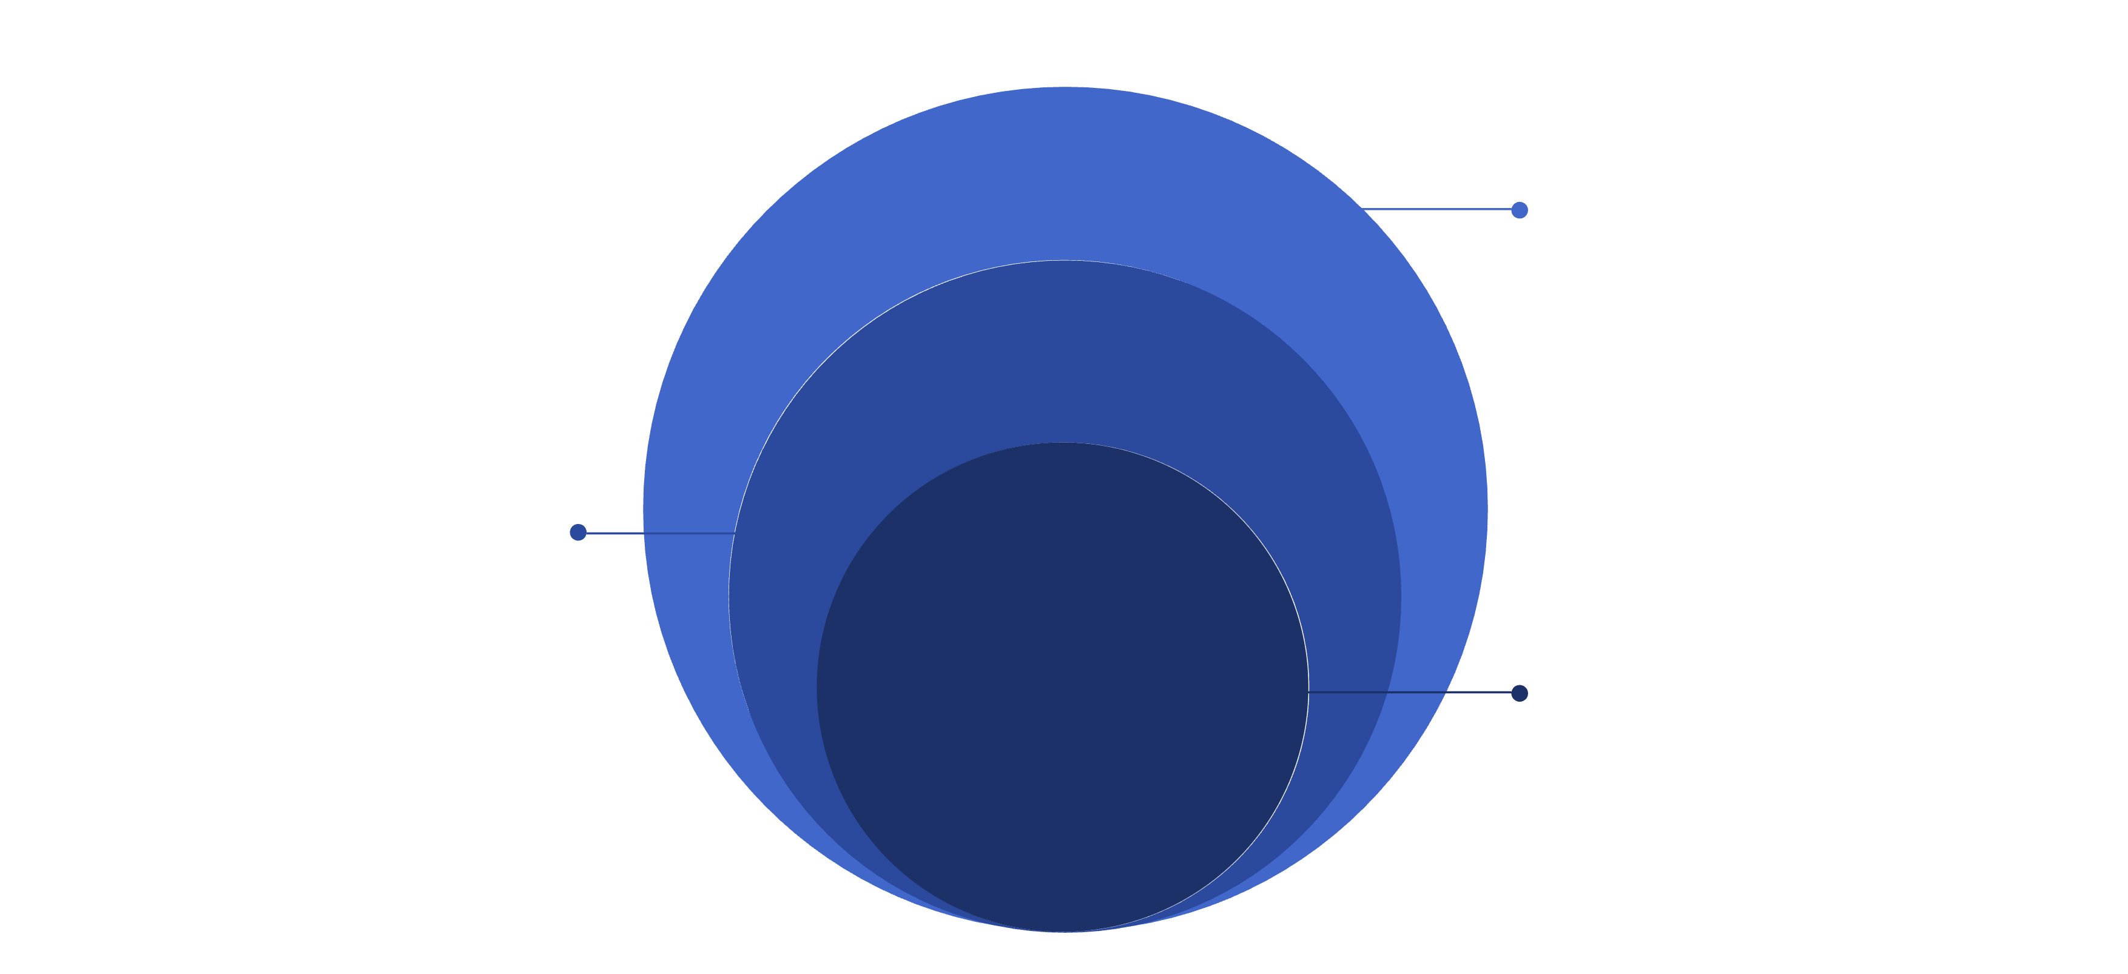
System Architecture
The PennyStack system is structured in a clear, layered architecture to ensure modularity, scalability, and maintainability.
Data & Storage
Doubly list, stack, queue, BST, file
Business Logic
Auth, transactions, billing, reporting
User Interface
Console-based interaction layer
This design promotes efficient data flow and clear separation of concerns, crucial for a complex application.

Slide 7
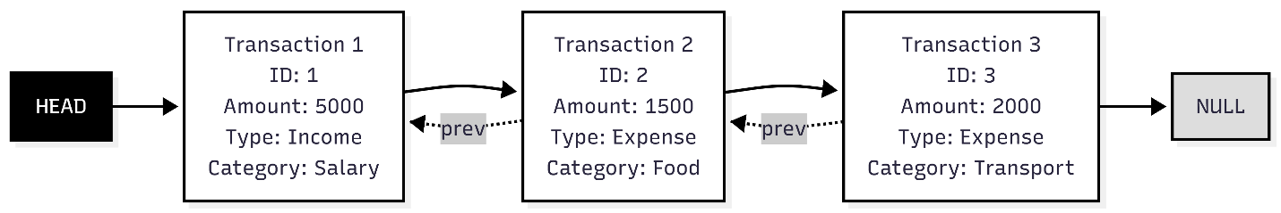
Doubly Linked List: Transaction History Management
The Doubly Linked List is fundamental to managing and navigating the user's transaction history with ease and efficiency.
Purpose
Structure
To store and enable seamless traversal of all recorded financial transactions.
Each node represents a transaction, linked bidirectionally for forward and backward navigation.
HEAD → [Trans 1] ⇄ [Trans 2] ⇄ [Trans 3] → NULL
Key Operations
Why Doubly Linked?
Insert at front: O(1)
Facilitates bidirectional traversal.
Delete node: O(1)
Enables easy deletion of specific transactions.
Traverse both directions: O(n)
Offers dynamic sizing without memory waste.

Slide 8
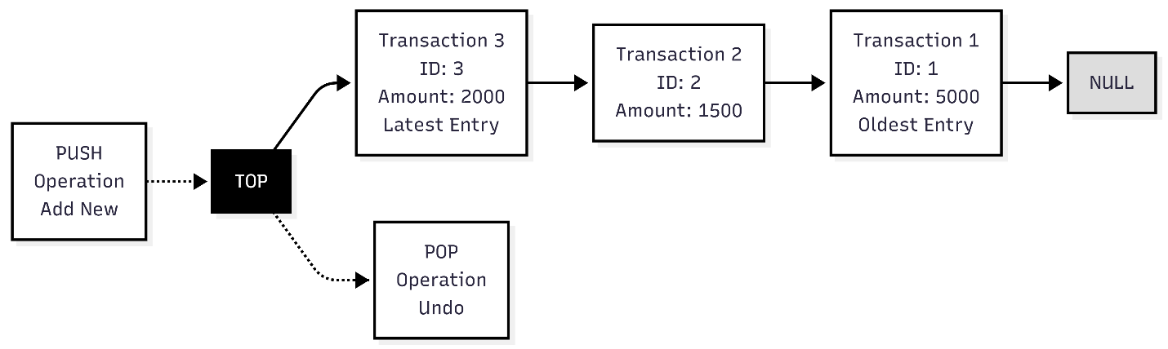
Stack (LIFO): Undo Functionality
The Stack data structure provides a Last-In, First-Out (LIFO) mechanism, essential for PennyStack's instant undo functionality, allowing users to correct mistakes effortlessly.
Purpose
Undo your last action instantly.
Structure
Last action added is first to undo.
Operations
Example
Add: O(1)
Made a mistake? Click undo and it's gone!
Remove: O(1)
Check: O(1)

Slide 9
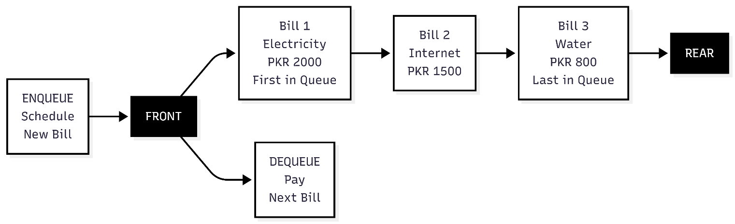
Queue (FIFO): Bill Payment Scheduling
The Queue data structure ensures fair and organised bill payment processing by adhering to a First-In, First-Out (FIFO) principle.
Purpose
Pay bills in order, never miss a deadline.
Why Queue?
Bills paid fairly, no bill forgotten, avoid late fees.
Operations
Structure
Add O(1), Remove O(1)
First bill scheduled is first to pay.

Slide 10

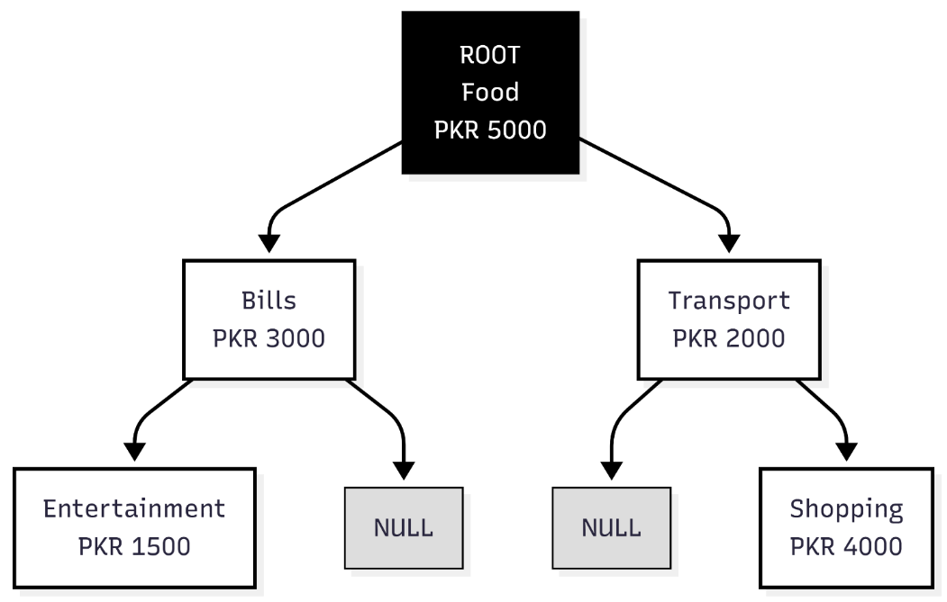
Binary Search Tree: Category Organisation
A Binary Search Tree (BST) is employed for fast, category-based searching and organisation of financial data. This structure ensures alphabetically sorted categories and efficient retrieval.
Operations
Insert/Search/Delete: O(log n)
Structure
[Food:5000] [Bills:3000] [Transport:2000]
Purpose
Fast category-based searching

Slide 11
Benefits of BST for Financial Categories
The Binary Search Tree offers several advantages for managing financial categories, contributing to a fluid and responsive application.
Alphabetically Sorted
1
Categories are always presented in a clear, organised manner.
Fast Search & Retrieval
2
Quickly locate specific spending patterns or income sources.
Efficient Updates
3
Adding or modifying categories is handled with optimal performance.
Visual Hierarchy
4
Represents spending in a structured, easily understandable tree format.

Slide 12



Hashing: Secure PIN Authentication
Hashing is fundamental to securing user data, especially for PIN authentication, providing robust, one-way encryption for sensitive information.
Purpose
1
Protect user data and ensure secure login with encryption.
Hash Function
2
hash = (PIN % 1000) × 5 + 7
Process
3
User PIN (2471) → Hash Function → Stored Hash (2362). Login PIN → Hash Function → Computed Hash → Compare → Access Granted.

Slide 13
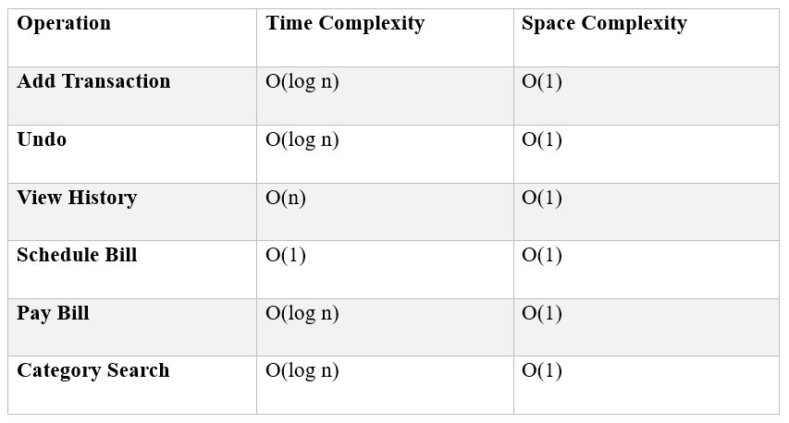

Slide 14




Hashing for Enhanced Security
Our hashing implementation ensures that user authentication is not only fast but also highly secure, safeguarding personal financial data.
One-Way Encryption
O(1) Verification Time
1
PINs are irreversible, adding a layer of security.
Instant authentication without performance bottlenecks.
2
Secure Authentication
4
No Plain-Text Storage
Protects against unauthorised access and data breaches.
3
User PINs are never stored in an accessible format.

Slide 15
System Capabilities
Key Features Overview
The application is designed with a comprehensive set of features to manage personal finances effectively, from transaction handling to advanced reporting and security.
1
2
Transaction Management
Undo Functionality
Add income/expense, automatic balance, category assignment.
Instant error correction with stack-based implementation.
3
4
Bill Scheduling
Transaction History
Queue-based management, fair payment order, reminder system.
Complete record viewing and chronological display.
5
6
Bill Payment
Category Reports
Balance verification, automatic processing, confirmation.
BST-based search for spending analysis and visual charts.
7
8
Data Persistence
Security
Automatic saving, file-based storage, session recovery.
PIN authentication, hash-based protection, access control.

Slide 16
User Experience
Login Screen & Security
The login screen combines a clean, professional interface with robust security measures to protect user financial data.
Features
Security
Clean, professional interface
Encrypted PIN storage
PIN-based authentication
No plain-text passwords
Hash verification
Instant verification
Access control
Access denied on wrong PIN
The system ensures that personal identification numbers are always encrypted and never stored in a readable format, providing peace of mind to the user.

Slide 17
Main Menu: Intuitive Navigation
The main menu offers a clear and easy-to-use interface, enabling users to quickly access all functionalities of the personal finance application.
Menu Options
Display Elements
Add Transaction
Current balance (top)
Undo Last Action
Clear menu structure
View Transaction History
Numbered options
Schedule Bill
Easy navigation
Pay Pending Bill
View Category Report
Exit
A prominently displayed current balance ensures users are always aware of their financial standing, while numbered options simplify interaction.

Slide 18


Core Operations in Action
Demo: Adding a Transaction
Witness the seamless process of adding a new financial transaction, from input to confirmation and data saving, highlighting the system's efficiency.
Amount Input
Type Selection
Amount: 5000
Type: Income
Category Input
Confirmation
Category: Salary
✓ Transaction Added! ✓ Data Saved! Balance: PKR 5000.00
Time Complexity: O(log n) due to efficient BST insertion for expenses, ensuring performance even with a large number of transactions.

Slide 19
Demo: Undo Functionality
Experience the instant error correction provided by the undo feature, showcasing how easily users can revert mistakes and restore their balance.
Before Undo
Stack Operation
Balance: PKR 5000.00
Last Transaction: Income - Salary - 5000
POP → Remove last transaction
Update → Reverse balance change
After Undo
Save → Persist changes
Balance: PKR 0.00
✓ Last Action Undone! ✓ Data Saved!
Time Complexity: O(1)
The stack-based implementation allows for an immediate and efficient undo operation, guaranteeing data integrity and user convenience.

Slide 20
Demo Flow: Undo Operation
Understanding the immediate impact of the undo function, a critical feature for user control and error correction in PennyStack.
Before Undo
After Undo
Balance: PKR 5000.00
Balance: PKR 0.00
Last Transaction: Income - Salary - 5000
✓ Last Action Undone!
✓ Data Saved!
Stack Operation
Technical Efficiency
POP: Remove last transaction
Time Complexity: O(1)
Update: Reverse balance change
Design Notes: Emphasises immediate feedback and data integrity.
Save: Persist changes
Key Elements: Before/After comparison, Stack visualisation, Success message, Performance metric.

Slide 21


Demo Flow: Bill Management Simplified
PennyStack’s intuitive bill management system allows users to effortlessly schedule and pay recurring expenses, ensuring financial obligations are met on time.
Schedule Bill
Pay Bill
Next Bill: Electricity - PKR 2000
Bill Name: Electricity
Current Balance: PKR 5000
Amount: PKR 2000
1
2
✓ Bill Paid Successfully!
✓ Bill Scheduled!
New Balance: PKR 3000
Set up recurring payments with ease, preventing late fees and managing cash flow efficiently.
Confirm payments instantly with real-time balance updates and clear transaction records.
Queue Operations
Design Notes
Enqueue: Add to rear - O(1)
Clear payment flow with balance updates.
Dequeue: Remove from front - O(1)
Visual queue representation for pending bills.
Efficient processing of scheduled payments.
Ensures data integrity and seamless user experience.

Slide 22



Demo Flow: Category Report
Gain instant insights into spending habits with PennyStack's Category Report, allowing for effective financial analysis and budget management.
1
1
Category Input
Search Results Overview
Enter Category: Food
Category: Food
Total Spent: PKR 1500.00
Seamless search functionality for quick data retrieval.
Quickly view aggregated spending for any chosen category.
Technical Foundation
BST Search: O(log n) efficiency
Efficient category lookup
Sorted alphabetically for speed
Design Principles
Intuitive search interface
Clear bar chart visualization
Food
Transport
Bills
Optimised BST search path
The bar chart visually represents spending distribution, highlighting key expenditure areas at a glance.
Focus on performance

Slide 23
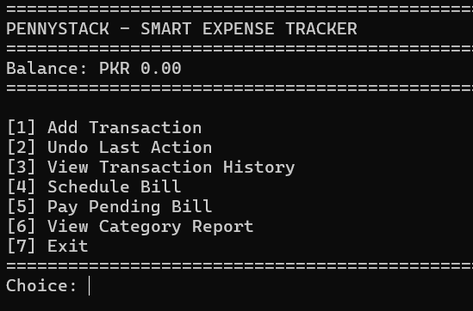
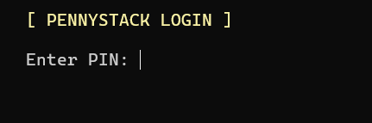
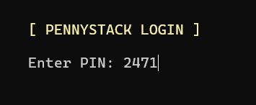
System Interface & Navigation
Login Page:
Login Page: Pin (2471)
Front Page.

Slide 24
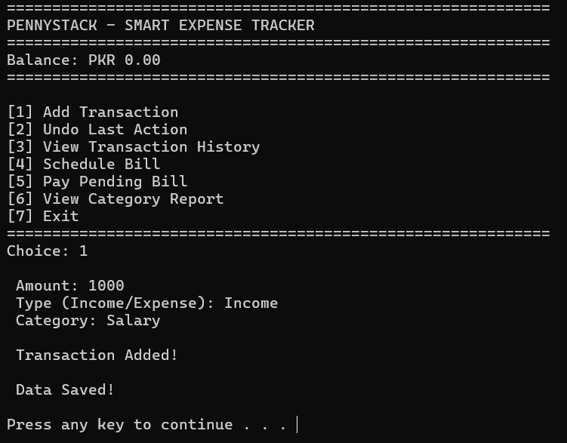
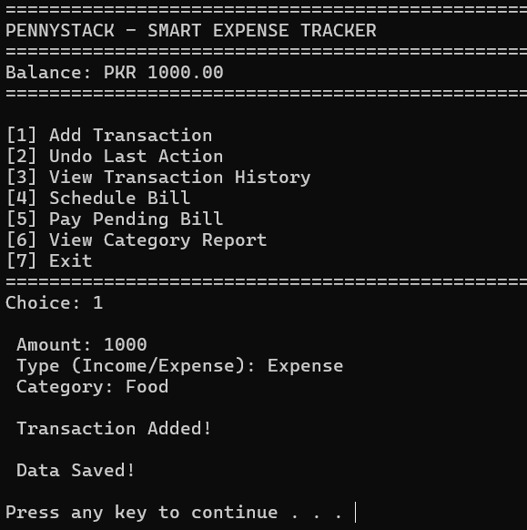
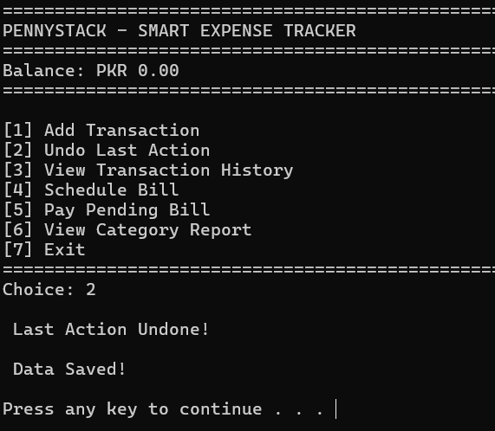
Core Transaction Engine
Add Income
Add Expense
Undo Action

Slide 25
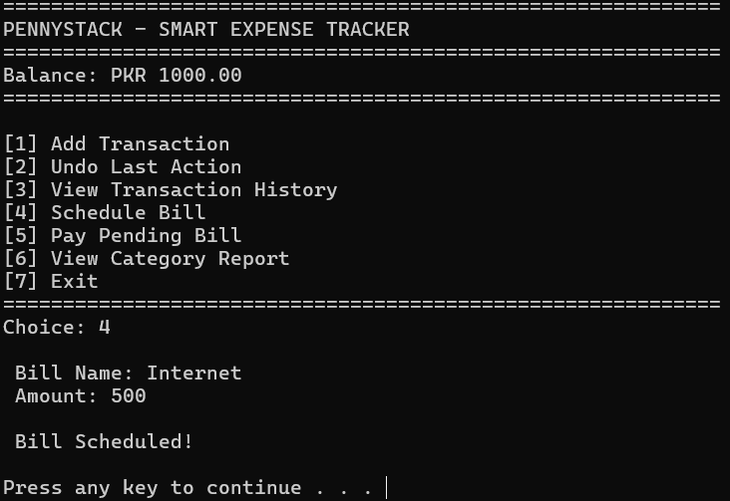
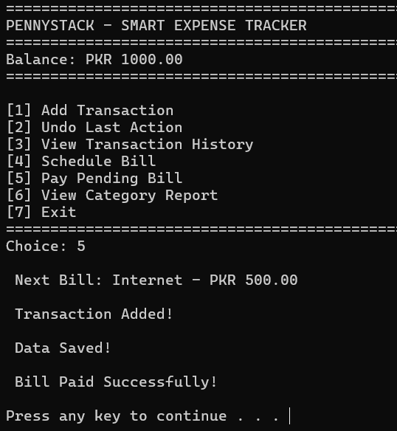
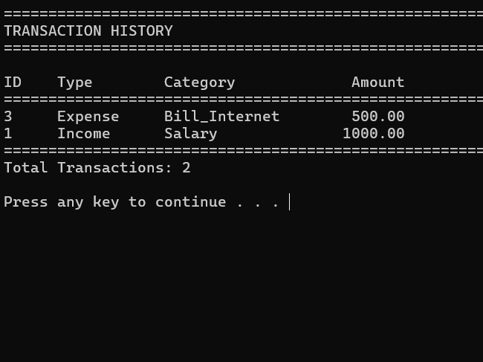
Advanced Analytics & Automation
Schedule Bills
Pay Bills
Transitions History

Slide 26
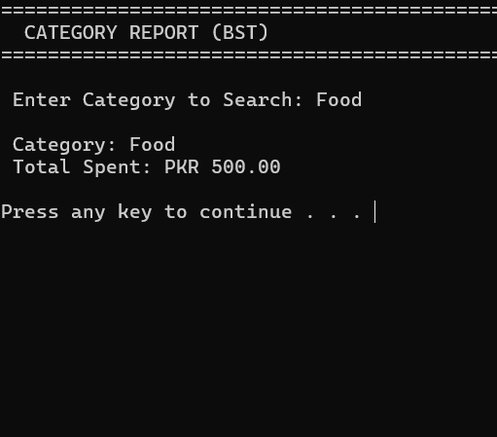
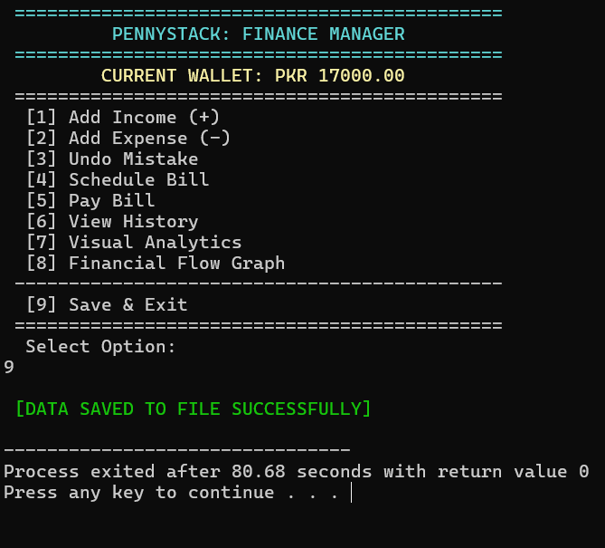
Visual Analytics & Insights
Spending Analytics
Category Report
Save & Exit

Slide 27
Implementation Highlights: Core Code Snippets
Explore the foundational code that powers PennyStack's robust functionality.
1. Add Transaction (Doubly Linked List)
2. Undo (Stack)
Transaction* newTrans = new Transaction;
newTrans->id = transactionID++;
if(head == NULL) {
head = tail = newTrans;
} else {
newTrans->next = head;
head->prev = newTrans;
head = newTrans;
}
Transaction* trans = stackTop->trans;
stackTop = stackTop->next;
delete trans;
Our undo mechanism relies on a stack for O(1) operation, enabling instant reversals.
3. BST Search
if(category == node->categoryName)
return node->totalSpent;
else if(category < node->categoryName)
return searchBST(node->left, category);
else
return searchBST(node->right, category);
This snippet ensures O(1) insertion, crucial for high-frequency transactions.
Binary Search Trees provide logarithmic time complexity for category searches.

Slide 28
Does Everything Work Perfectly? Testing Results
We rigorously tested PennyStack to ensure flawless operation across all features.
Test Summary
What We Tested
Total Tests: 12
Success Rate: 100%
Authentication (PIN login)
Transactions (Income/Expense)
Undo (Last transaction)
Categories (Search)

Slide 29

Problems and Solutions: Challenges We Faced
Every complex project presents hurdles. Here’s how we overcame key challenges in PennyStack.
Memory Leaks
BST Node Deletion
Undo with BST
Problem: Dynamic memory not freed correctly.
Problem: Complex node deletion with two children.
Problem: Updating category totals after undo operations.
Solution: Implemented a comprehensive destructor.
Solution: Utilized the in-order successor method.
Solution: Developed a dedicated updateBST function.
Result: Achieved zero memory leaks.
Result: Successfully handled all deletion cases.
Result: Ensured accurate category totals always.

Slide 30
Our Learning Journey: What We Learned
Developing PennyStack provided invaluable insights and practical experience.
Technical Skills Gained
Problem-Solving & Professional Skills
Learned data structures.
Solved project challenges.
Managed memory in C++.
Handled unexpected scenarios.
Handled file input/output.
Planned and documented code.
Improved code efficiency.
Communicated technical ideas.
Key Takeaway: Applying theory to real problems makes learning powerful!

Slide 31
What's Next for PennyStack? Future Enhancements
Our roadmap includes exciting new features and advancements to further enhance PennyStack.
1
2
Phase 1: Enhanced Features
Phase 2: Better Analytics
Date/time for transactions
Monthly/yearly spending reports
Monthly budget setting
Graphical charts & trends
Automatic recurring transactions
Spending predictions
Multiple user accounts
Budget alerts & notifications
3
4
Phase 3: Modern Interface
Phase 4: Advanced Integration
Graphical User Interface (GUI)
Connect to bank accounts
Mobile app (Android/iOS)
Direct in-app bill payments
Web dashboard with cloud sync
Cloud backup & sync
Touch-friendly design
Multi-currency support

Slide 32
Making a Difference: Project Impact
Educational Value
Practical Utility
Technical Achievement
Bridges theory and practice
Helps manage personal finances
5 data structures integrated
Demonstrates real-world applications
Provides spending insights
Efficient O(1) to O(log n) operations
Builds programming confidence
Enables better financial decisions
100% test success rate
Portfolio-worthy project
Offers easy expense tracking
Zero memory leaks
User Benefits
Easy expense recording
Quick balance checking
Category-wise analysis
Bill payment reminders
Error correction capability

Slide 33
Project Summary
PennyStack successfully demonstrates the practical application of data structures in solving real-world financial management problems.
1
Key Achievements
Implemented 5 core data structures effectively
This project proves that choosing the right data structure is crucial for building efficient, scalable applications. Theoretical concepts have direct, practical applications in solving everyday problems.
Achieved efficient O(1) to O(log n) operations
Created user-friendly expense tracking system
Ensured data security and persistence
Passed all test cases with 100% success rate
2
Learning Experience
Gained hands-on experience with data structures
Developed problem-solving skills
Learned software development lifecycle
Improved coding and debugging abilities
Enhanced teamwork and collaboration

Slide 34
Thank You for Your Attention!
PennyStack: Smart Personal Expense Tracker
Abdul Rafay (243705)
Air University Multan Campus - Data Structures - Spring 2025
Questions?

